Slide 1
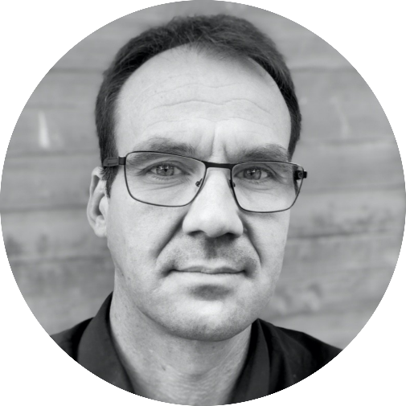
Opening
Adrien Badel – Head of Polytech Annecy Chambéry

Slide 2
JFWM2022 Program
Adrien Badel – Head of Polytech Annecy Chambéry

Slide 3



Facts
4
Universities
5
Companies
45
Students

Slide 4
Program
Lectures
Keynotes
Tutorials
Practical work

Slide 5
Challenge
Fabien Formosa – Professor, Polytech Annecy Chambéry
Hugues Favrelière – Assistant Professor, Polytech Annecy Chambéry
Luc Marechal – Assistant Professor, Polytech Annecy Chambéry

Slide 6
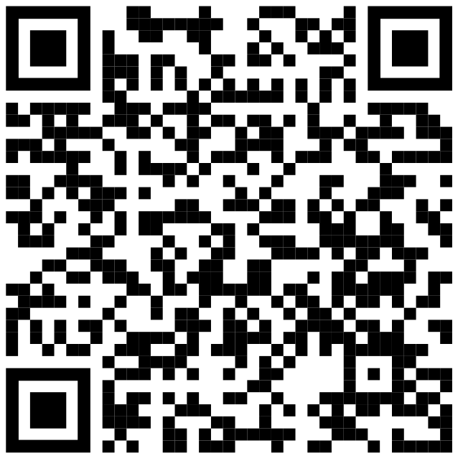

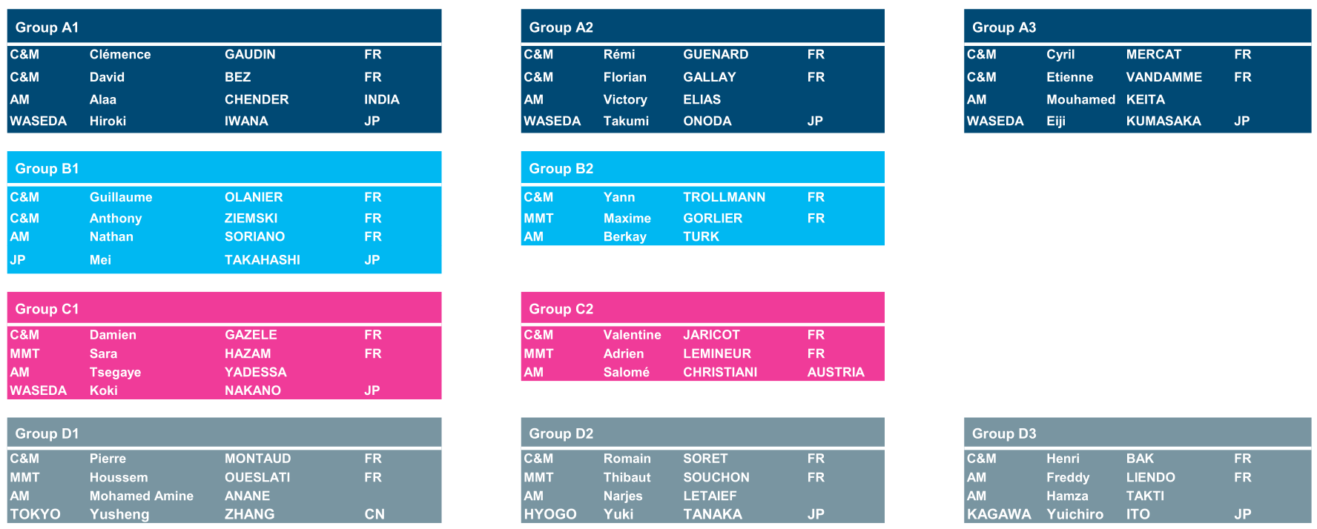
Groups
6 TEAMS of 7 students
ALLOCATED group letters and students names

Slide 7


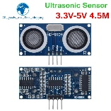
Challenge brief
DEMONSTRATE a functional 4DOF robotic arm using achieving a specific “surface tracking” motion
I
II
III
Grab the sensor
Move the sensor to the operation zone
Track the surface
IV
Drop the sensor back

Slide 8
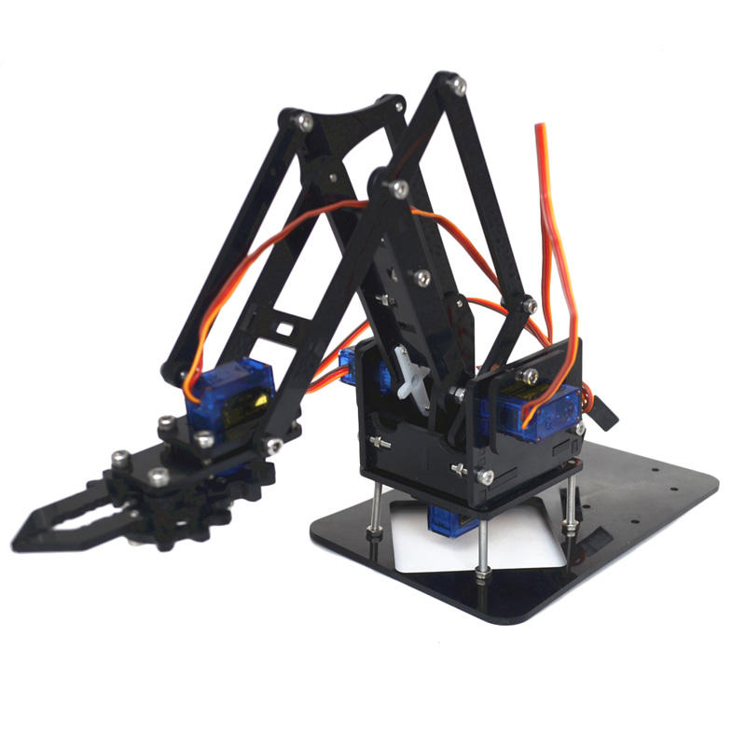
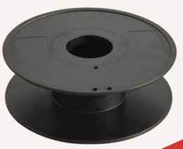
Challenge performance criteria
mechanical interface (arm with frame & gripper with sensor)
MINIMIZING the material mass
MINIMIZING the number of mechanical parts
MAXIMIZING the stiffness
Control
MINIMIZING the distance between sensor and tracked surface
AVOIDING any contact with the surface
MAXIMIZING the speed

Slide 9

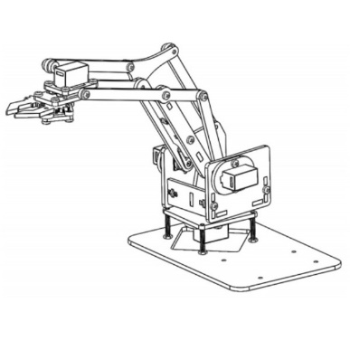
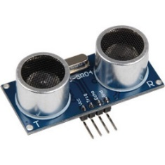

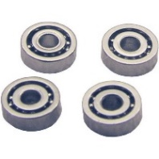
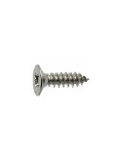
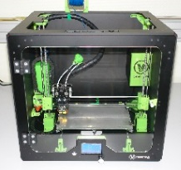
Challenge rules
SIX to SEVEN students mixed teams
OPERATING a functional 4DOF robotic arm using
USING an ultrasonic distance sensor
DESIGNING mechanical interfaces
Robotic arm with frame
Sensor with arm gripper
FABRICATING using rapid prototyping

Slide 10
Timeline
Thursday September, 8
2 x 90’ min (all groups)
Monday September, 12
3 x 90’ min (all groups)
Tuesday September 13
1 x 90’ min (all groups)
Wednesday September, 14
180’ min (all groups)
Thursday September, 15
3 x 90’ min (all groups)
Friday September, 16 Final demonstration
Professors will discuss and define which is the best accomplishment
(achievement of goals + demonstration + teamwork)

Slide 11
Day trip Saturday 10

Slide 12
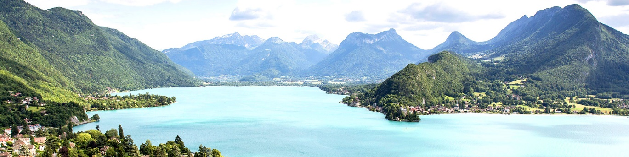
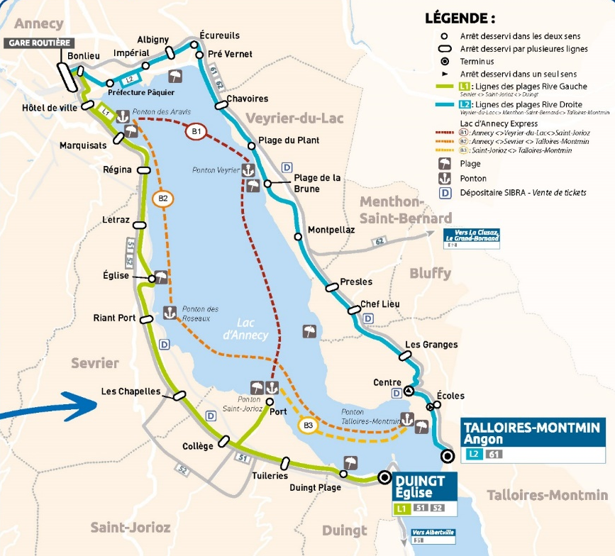
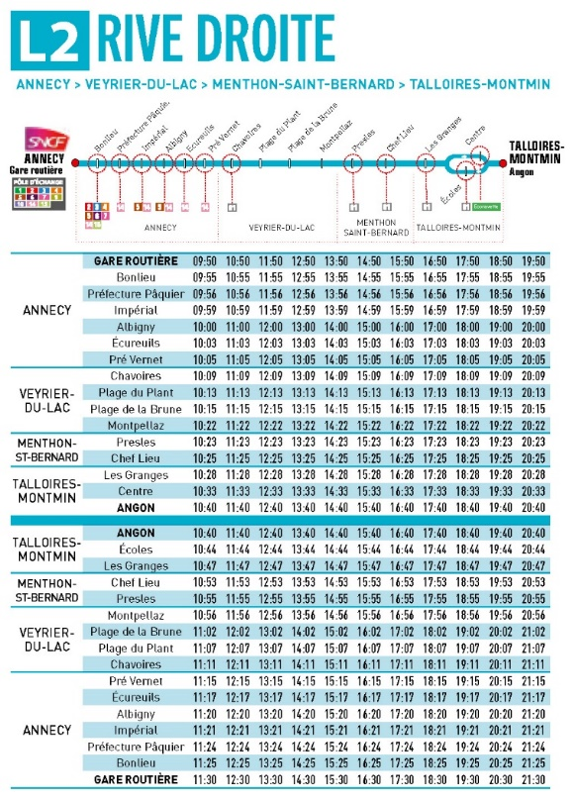
Day trip
10:30 Talloires
Bus line L2

Slide 13
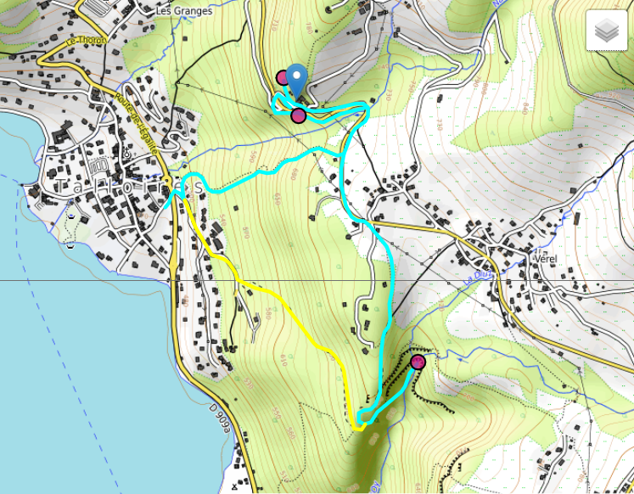
Day trip
Hike at
Hermitage Saint-Germain and Angon Waterfall
about 2h walk.
Take sports shoes !
Snack lunch at Talloires beach

Slide 14
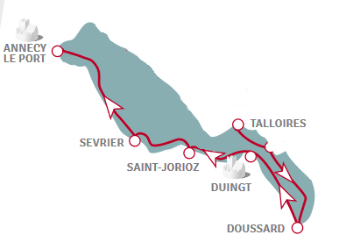
Day trip
14:50
Boat cruise to Annecy
or
Back with bus L2
Answer the survey !

